Slide 1


On the Road to Green Campus Experience of Da-Yeh University
台灣綠色大學聯盟第3屆第1次會員大會, 國立暨南國際大學
Yi-Ching Chen, Ph.D.
Da-Yeh University,
Changhua, Taiwan
大葉大學
環境工程系/
環境教育中心 主任
Notes:
For Da-Yeh University (DYU), the green concept was initiated by the facts that reducing the massive resources used, such as electricity, water, oil and others during the operation.
The concepts of sustainable development as well as environmental protection then were assimilated into the university's education. The development of green campus can actually enhance the environmental awareness of all students and staffs in University.

Slide 2

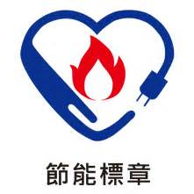
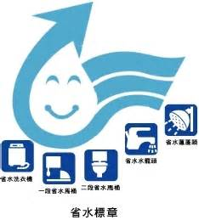
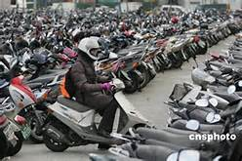

Why DYU need to be GREEN?
We are actually green
Energy saving
Water recycling
Green Traffic
Educating sustainablility
Notes:
This is the content of to day’s presentation
We always ask ourselves why DYU need to be “GREEN”

Slide 3
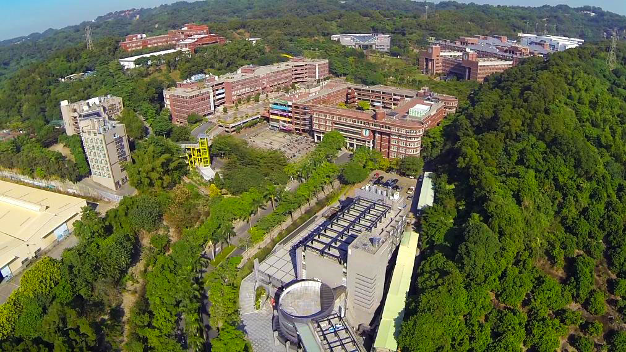
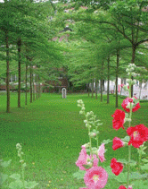
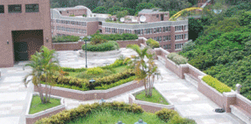
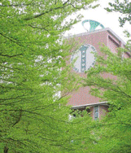
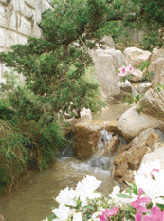
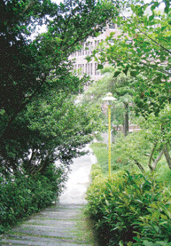
A Beautifual and Green Covered Campus
31 acres campus with 82.7% green coverage area
Notes:
DYU has a unique green campus environment with 82.7% green coverage area .
and the environmental education and sustainable development are promoted with long-term investment by all staffs and students.
Show video 翱翔大葉

Slide 4
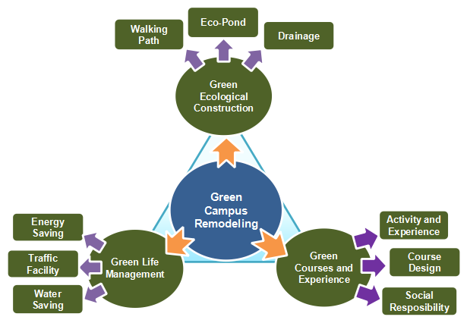
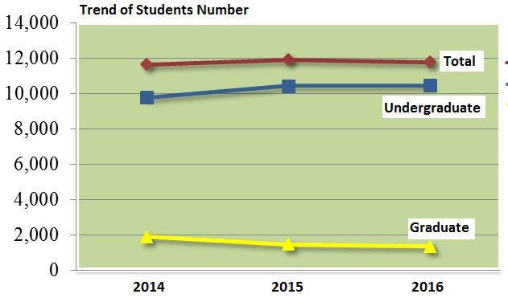
Trilogy of Green Thinking Blueprint
Blueprint of green campus in DYU
Notes:
While the university is in operation more than 27 years with 12,350 students and staffs now, it cannot be avoided that massive resources are used and large amounts of waste are produced. These substances will eventually become environmental problems for the campus and neighboring communities.
DYU develop its own blueprint of sustainable management strategies for school development. The trilogy, such as green ecological construction, green life management, and green courses and experience is the major category for long-term developing.

Slide 5
Sustainable Management Strategies for DYU Development
(1) Highlight the healthy campus with ecological environment
* ecological mountain trail in campus
* landscape ecological pool
* environmental interpretation system in campus
* sustainable environmental education
(2) Promote the campus energy saving and carbon reduction system
* a sustainable environment system
* a sustainable environmental management
* green procurement
* waste management
(3) Create a friendly and barrier-free campus
* comfortable and convenient six-vehicle traffic network
* Build a barrier-free campus environment
(4) Sustainable and security campus network
* promoting the campus environment to enhance safety and health
* strengthen the waste management operations in laboratories
Notes:
What are the categories to develop our green campus blueprint
Four categories
Highlight the healthy campus with ecological environment
Promote the campus energy saving and carbon reduction system
Create a friendly and barrier-free campus
Sustainable and security campus network

Slide 6
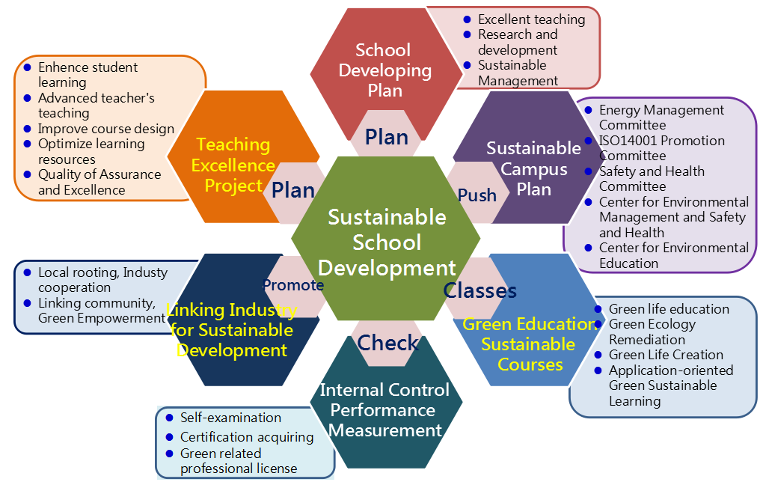
Completed Framework of Sustainable Campus Development
Notes:
In 1996, Australian scholar Dyer, C. argued that schools should develop specialized disciplines of environmental education and embody a comprehensive concept of environmental sustainability into all courses and campus lives.
The school, DYU, has its own long-term framework for sustainable school development by committee of sustainable development directed by president and well-literacy members. Also, the certifications of ISO14001 environmental management system and ISO50001 energy management system can prove the well performance of this framework.

Slide 7
Accomplishment of Energy Saving
Calendar year | 2014 | 2015 | 2016
Total student/staff | 12,211 | 12,474 | 12,351
Total floor area (m²) | 199,102 | 199,102 | 199,102
Annual Electricity Consumption (kW-hr) | 14,353,600 | 14,773,200 | 14,924,351
Reduced Rate compared with 2013 | 3.25％ | 2.84％ | 1.02％
Electric Use Intensity (kW/m²) | 72.1 | 74.2 | 74.9*
Average Electricity Consumption Per Person (kW-hr/ca) | 1,176 | 1,184 | 1,208
* The EUI performance of 74.9 is excellent compared with average of 98.2 for all universities in Taiwan.
Notes:
The electricity and water are major consumption for a large campus with more than 12,000 members. It needs a series reduction operation to achieve, however, without lowering down quality of campus life. Several facilities have been accomplished, such as campus energy monitoring system, intelligent air conditioning management system for large building, automatic electricity scheduling system for classrooms, solar hot water system for dormitory, LED lighting replacement for public area of building, and library building energy saving.
The EUI performance of 74.9 is excellent compared with average of 98.2 for all universities in Taiwan. The average electricity consumption per person performance of 1,208 kW-hr is also much lower compared with average of 1,890 kW-hr in Taiwan population.

Slide 8
Accomplishment of Water Conservation
Calendar year | 2014 | 2015 | 2016
Total student/staff | 12,211 | 12,474 | 12,351
Total water consumption (ton) | 153,639 | 145,027 | 140,016
Rate of Conservation compared with 2013 | 1.8％ | 7.9％ | 10.5%
Annual average water consumption per person (ton/ca) | 12.8 | 12.1 | 11.3*
* The average water consumption per person performance of 11.3 ton is also much lower compared with average of 39.4 ton for all universities in Taiwan
Notes:
the accomplishment of water conservation has extremely performing to reach 10.5% reduction
with campus water monitoring system, rain water collection system, sewer recycle system, and water saving equipments, etc.
The average water consumption per person performance of 11.3 ton is also much lower compared with average of 39.4 ton for all universities in Taiwan.

Slide 9
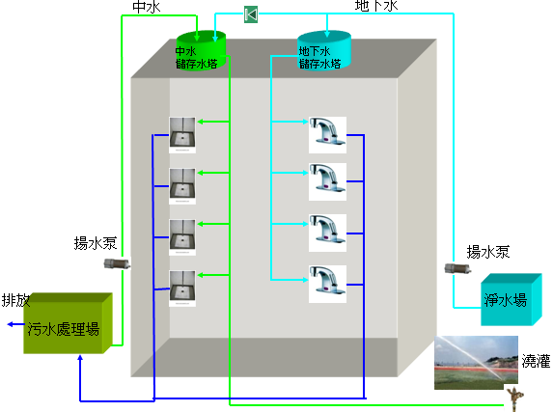
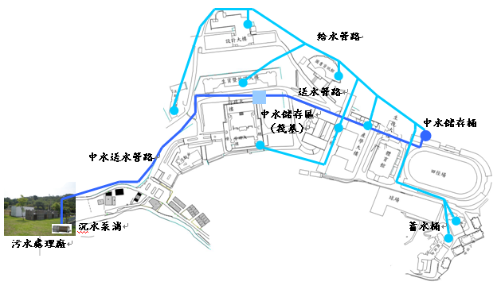
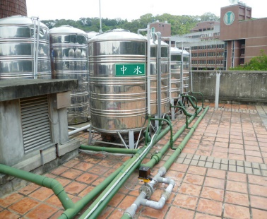
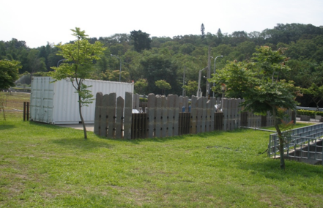
Sewer Effluent Water Reclaim
A MBR wastewater treatment system with capacity of treating 1,200 tons of wastewater per day can supply 300 ton high quality recycled effluent water for toilet flushing and lawn watering.
Notes:
Campus sewer recycle system, each building has two water supply systems, tape water for drink & wash, sewer recycle water for toilet flushing.
rain water collection system by slope gravity for another building use

Slide 10
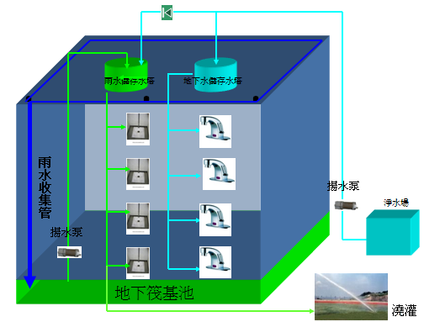
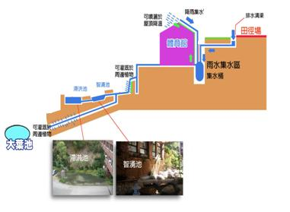
Rainwater Reclaim
Hill slope gravity transport
位置 | 筏基蓄水槽容量 (噸)
外語大樓 | 5,208
活動中心 | 2,325
產學大樓 | 3,640
體育館 | 72
合計 | 11,254

Slide 11
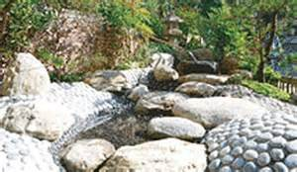
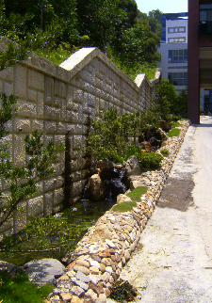
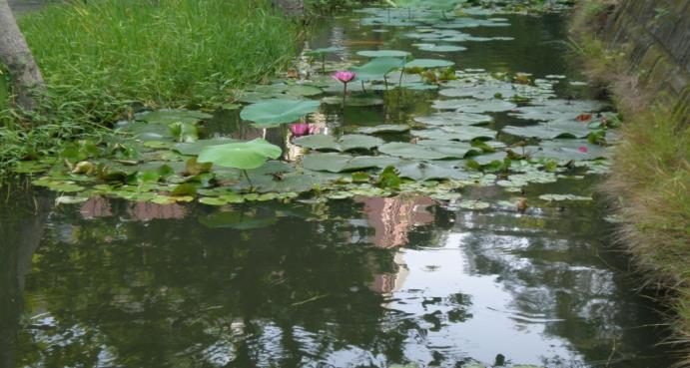
Spring Water Reclaim
Eco rebuild (wetland)
Landscape
Lawn Watering

Slide 12
Accomplishment of Waste Management
Calendar year | 2014 | 2015 | 2016
Total student/staff | 12,211 | 12,474 | 12,351
Total amount of garbage (kg) | 247,220 | 282,810 | 277,130
Average amount of garbage produced per person (kg/ca) | 20.25 | 22.67 | 22.44
Total amount of recycled garbage (kg) | 98,871 | 95,324 | 96,763
Rate of Recycle | 39.99% | 33.71% | 34.92%*
* The resource recycled has been done in good condition to get almost 35% accomplishment.However, there is still a goal to reach compared with the whole average recycle rate of 55% in Taiwan.
Notes:
Garbage produced and wastewater treatment need to be mostly concerned to reach the road green campus. The resource recycled has been done in good condition to get almost 35% accomplishment.
However, there is still a goal to reach compared with the whole average recycle rate of 55% in Taiwan.
The school installed a MBR wastewater treatment can produce 300 ton high quality recycled effluent water is used for toilet flushing and lawn watering.
The effluent water, with removal rate of 94% BOD, 83% COD and 98% SS, has always fulfilled the requirements established by the Taiwan EPA criteria.

Slide 13
Accomplishment of Transportation Management
Calendar year | 2014 | 2015 | 2016
Total user (person time) | 858,568 | 886,365 | 999,530
CO₂ Reduction (kg) | 525,614 | 542,631 | 611,910
DYU has provided students and university staffs with a safe, comfortable and convenient six-vehicle transportation network system for traffic safety and green transportation
Notes:
DYU is located at foot of Ba-Gua Mountain. The road condition is actually not good in country area. Motorcycle is most common transportation vehicle for students. The accidental events happen very often.
For the sake of traffic safety and green transportation, DYU has provided students and university staff with a safe, comfortable and convenient six-vehicle transportation network system.
shuttle bus service from Taichung High Speed Rail station,
local bus service in Yuanlin area,
contracted school bus system,
off-campus shuttle bus network,
campus shuttle bus service,
contracted taxi service.

Slide 14
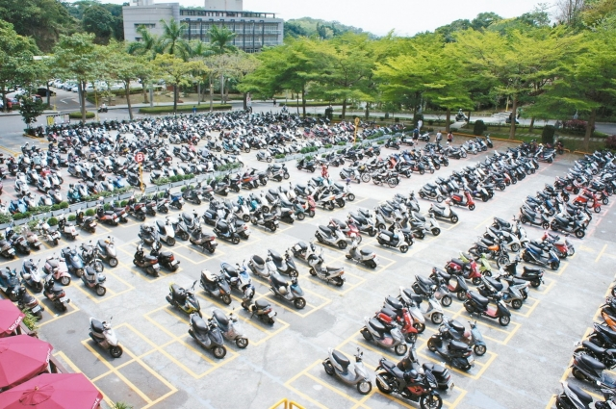
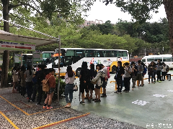
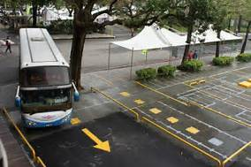
Motobike Parking→ Bus Terminal

Slide 15
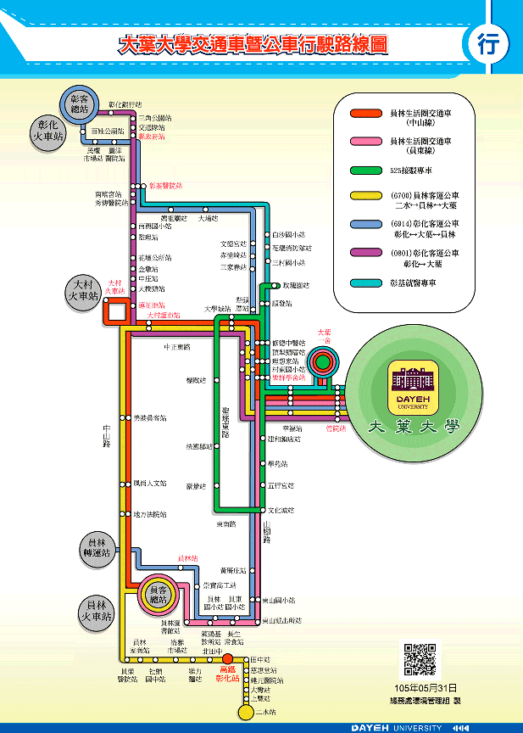
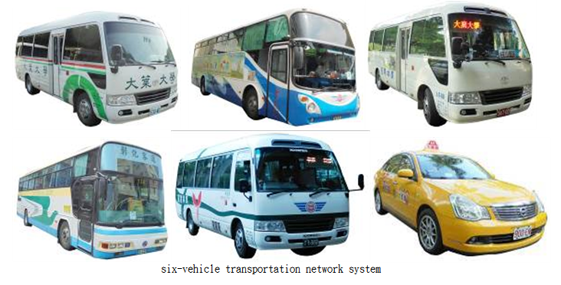
six-vehicle transportation network

Slide 16
Teaching Excellence Performance
DYU encourages different areas of teaching with the relevant issues to teach, design environmental issues and problem based learning PBL.
The social context can be connected and the green life education connotation can be implemented.
In the general green curriculum, a large number of planning related topics, such as: energy technology and environmental sustainability, people and the environment, marine and human sustainable development, natural ecology and life education are planned.
The university social responsibility (USR) is promoted and a responsible global citizen is expected for students.
Notes:
The purpose of the subprogram in Teaching Excellence Project supported by Ministry of Education (1.3 mollion US$) is to promote the green and sustainable concept of curriculum planning. DYU encourages different areas of teaching with the relevant issues to teach, design environmental issues and problem based learning.
CSR (corporate social responsibility )→ USR ( social responsibility

Slide 17
Summary
DYU has done to shape a multiple environmental quality aspects with good mountains, good water, and good life.
DYU recognizes that creating a sustainable campus can actually strengthen its core research and teaching mission.
Therefore, it is the road to green campus we have to reach without regret.

Slide 18
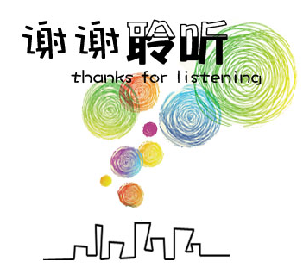
Acknowledgement
DYU Thanks to Green University Union of Taiwan

