Slide 1

Green NCNU in the Heart of Taiwan
Ku-Fan Chen, Ph. D.
Environmental Protection and Occupational Safety and Health Center, National Chi Nan University

Slide 2
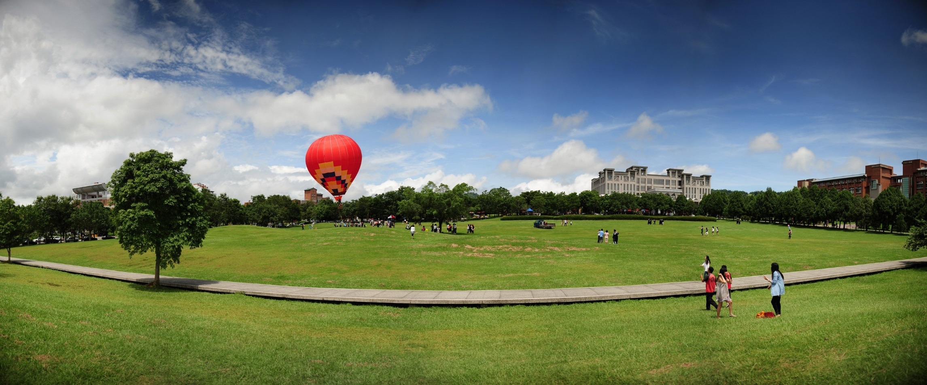
Outline
Foreword: NCNU, Marching Towards Sustainable Development
I.
Organizational Structure for Crucial SD Aspects
II.
III.
Sustainable Development Diagram and Results
VI.
Major Tasks and Current Objectives
Future Aspirations
V.
Photography by Chen Ching-Po

Slide 3

I. Foreword: NCNU, Marching Towards Sustainable Development (1/2)
NCNU was founded in 1995 at Puli Township.
NCNU shoulders the responsibilities of "overseas Chinese education", recruiting students from overseas, and creating a world-class university with unique characteristics.
"Balancing regional development", playing the role of local think tank to cultivate new talent.
The words "Chi Nan" comes from the "Yu Gong" chapter in the Book of Documents, "to the utmost limits (Chi) of the north and south (Nan), fame and influence spread everywhere across the four seas"

Slide 4
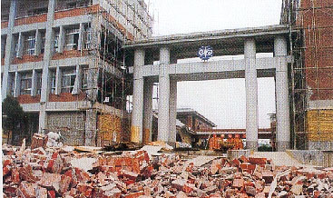
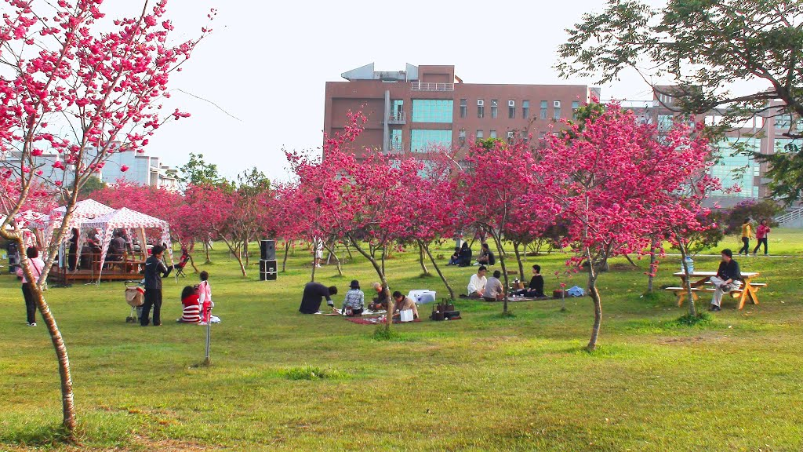
I. Foreword: NCNU, Marching Towards Sustainable Development (2/2)
In 1999, NCNU sustained serious damages during the Jiji earthquake, after the disaster, the question of "what does this catastrophe mean for NCNU in terms of its future development?" has attracted the attention of NCNU staff members and students.
After the earthquake, NCNU actively participated in rebuilding the community.
Now, NCNU and the Shui Sha Lian region have developed into co-dependent communities.
Learning and cooperating with locals after a disaster
A transformed NCNU

Slide 5
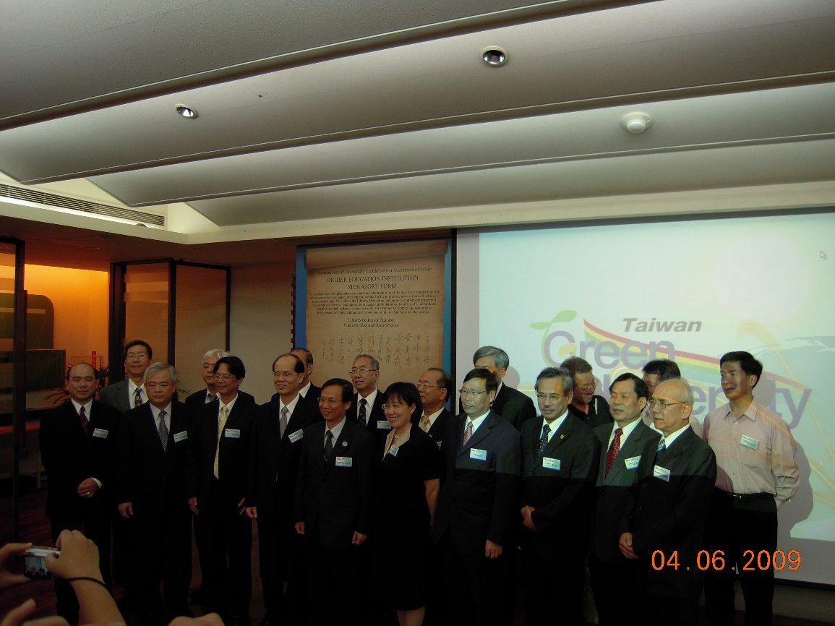
II. Organizational Structure for Crucial SD Aspects(1/2)
In 2009, NCNU was recognized by the Ministry of Education as one of 13 model green universities, and signed the internationally recognized "Talloires Declaration" just before World Environment Day.
To realize a sustainable campus culture to influence nearby elementary and middle schools, communities, and societies.
Notes:
義守大學、元智大學、高雄大學、勤益科技大學、嘉義大學、暨南國際大學、臺南大學、臺灣師範大學、健行科技大學、朝陽科技大學、慈濟大學、臺北醫學大學、中正大學等13所大學

Slide 6
II. Organizational Structure for Crucial SD Aspects(2/2)
University President
Green University Promotion Committee
Environmental Health and Safety Center
General Education Center
Education Development Center
Education Quality Control Committee
Shui Sha Lian Humanities Innovation and Social Activism Research Center
Promote green university project plans
Become the community design and innovation think tank, integrating local and university resources
Cultivate outstanding talent, implement holistic education
Strengthen teacher development, education promotion, and educational excellence
Environmental Health and Safety Committee
University and Local Partnerships Committee

Slide 7
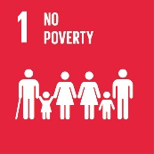
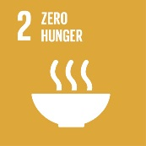

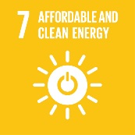

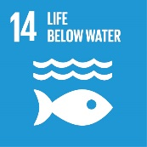





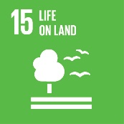

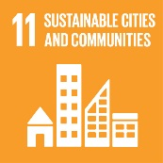




3.Provider of social care
Immigrants
Aboriginals
Minority Students
Senior Care
III、NCNU Sustainable Development Diagram
1.Environmentally-friendly activist
Renewable energy
Save energy and cut carbon emissions
Green purchases
Green architecture
Reduce sewage discharge
5.Practitioner of corporate social responsibility
Set up multiple communication channels and create trustworthy, win-win relationships with an open attitude
Create a safe culture of mutual care and discipline
Value school management and shape school ethics
Promote school culture, deepen societal care, and coexist with society
4.A leader in community development
In response to topics such as "ecological town, social care, green economy, cultural revitalization, and civic participation", conduct in-depth discussions and project designs, creating and building up new energy for community building
Create global partnerships in sustainable development
2.Educator of sustainable development
Place of environmental education
General and professional courses on sustainability
Culture Preservation
Career Development
NCNU Sustainable Development Diagram

Slide 8
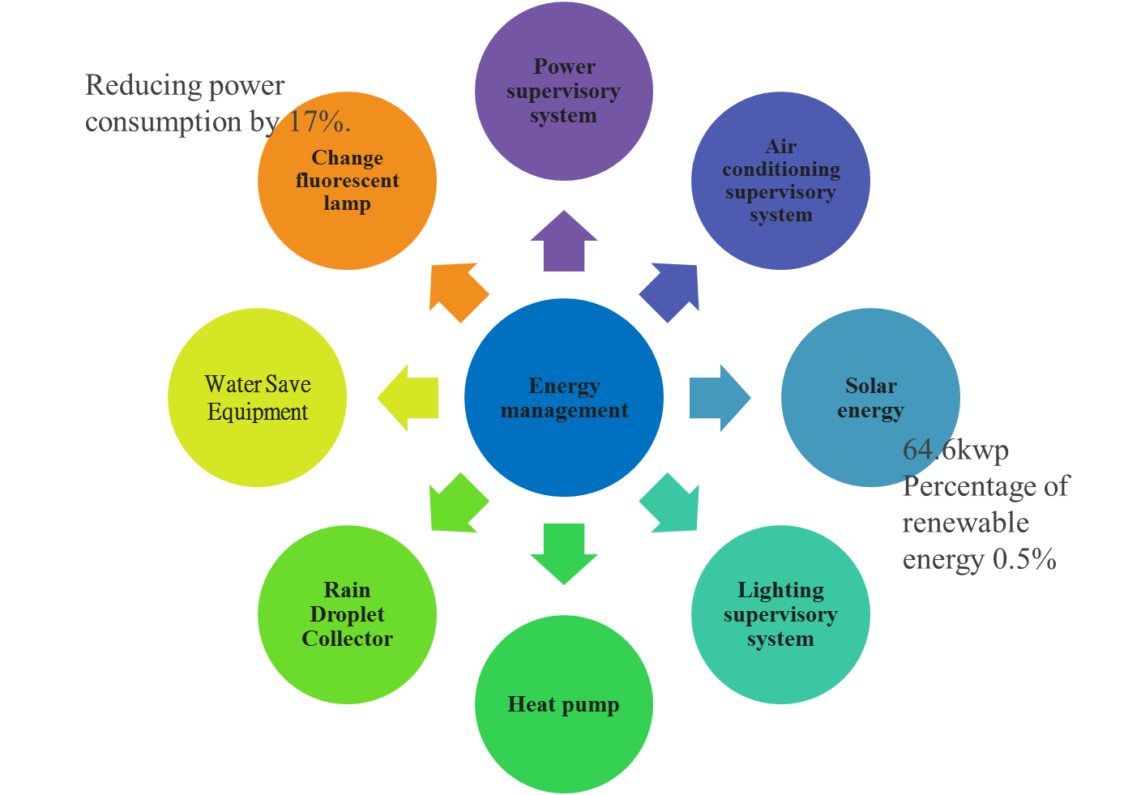
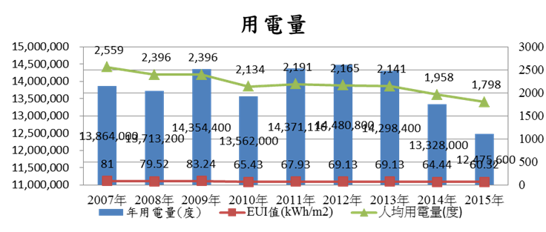
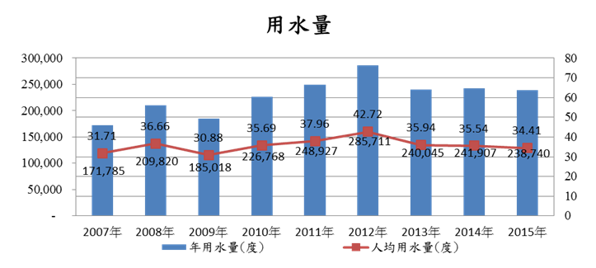
1.Environmentally-friendly activist (1/5)
Power consumption
water consumption
Awarded first place in the university division of "schools with excellent energy conservation" by the Ministry of Education

Slide 9
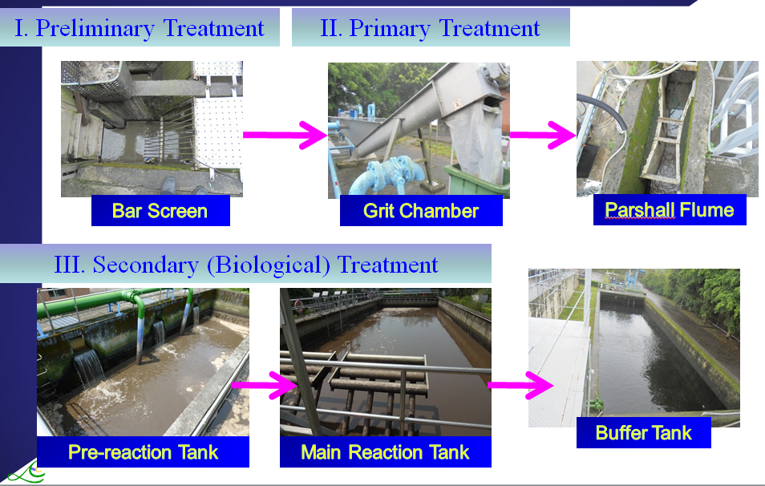
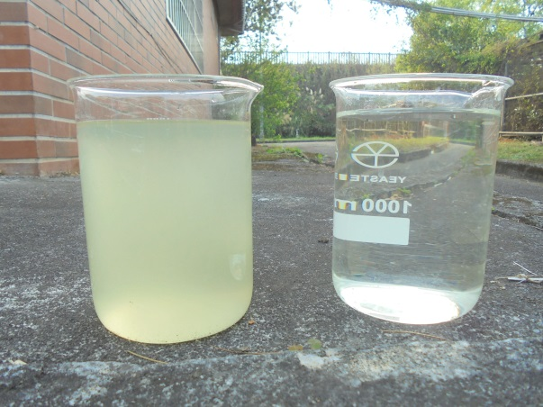
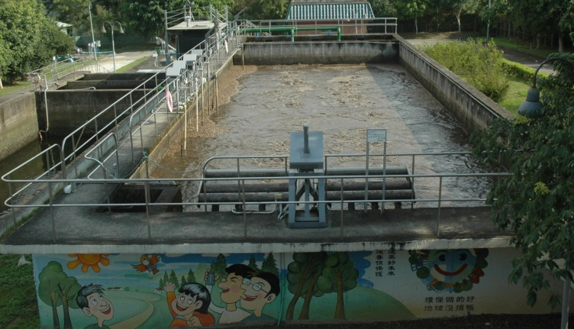
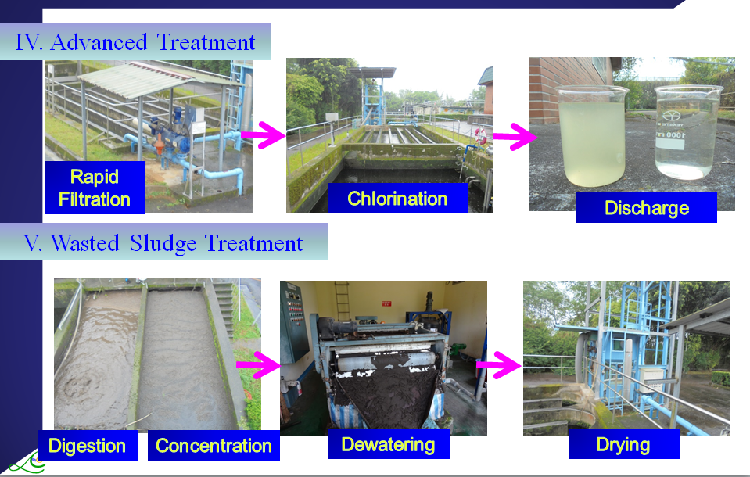
1.Environmentally-friendly activist (2/5)
Wastewater Treatment
Continuous Sequencing Batch Reactor (SBR)
Fill (continuous
Influent)
React
Settle
Draw
Idle
I. Anaerobic
II. Aerobic
III. Anoxic
IV. Reaeration

Slide 10
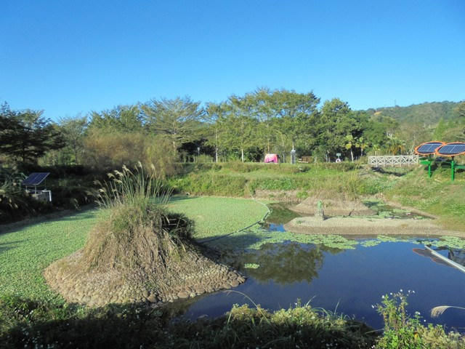
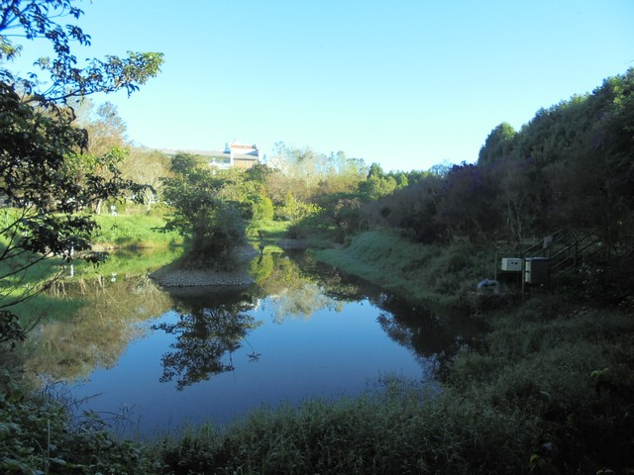
1.Environmentally-friendly activist (3/5)
Reclaimed Water System
Amount
About 60-80% (up to 560 tons/day) of the treated water is recycled.
Application
Eco-pond (I)
Irrigation
Eco-pond
Toilet flushing
Others
Advantages
Conserving water resource
Saving money
Protecting receiving surface water
Eco-pond (II)

Slide 11
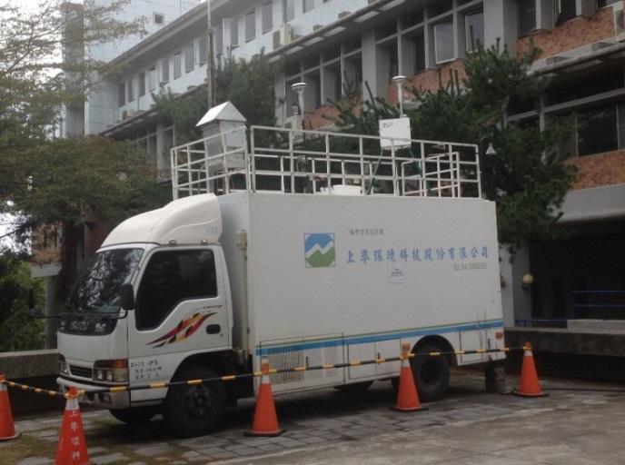
Drinking Water Quality Analysis
Indoor Air Quality Monitoring
1.Environmentally-friendly activist (4/5)
Waste Collection & Recycling
Food Waste Recycling
Recycling Bins
Ambient Air Quality Monitoring

Slide 12
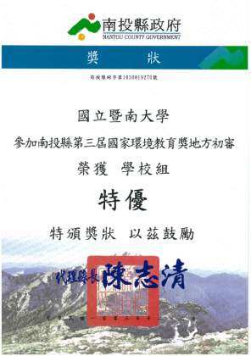

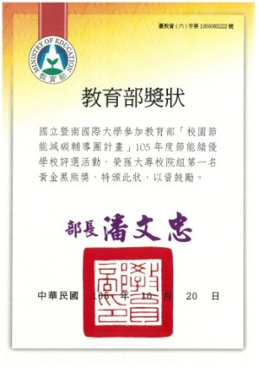
1.Environmentally-friendly activist (5/5)
ISO14001 for Teaching, Research, Administration and Consultation
Outstanding Award for Implementing Environmental Protection Awards (Taiwan EPA)
Excellence Award for Campus Environmental management (Ministry of Education)
Excellence Award, The 3th National Environmental Education Awards (Nantou County)

Slide 13
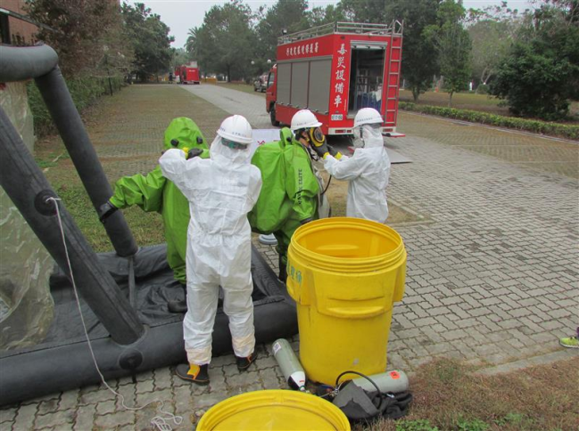
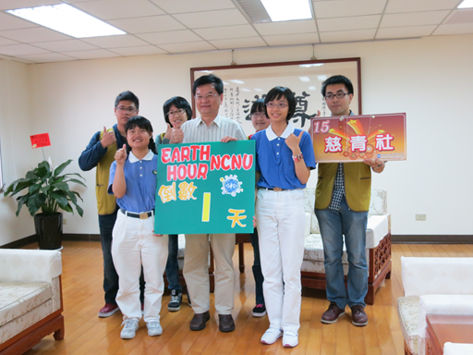
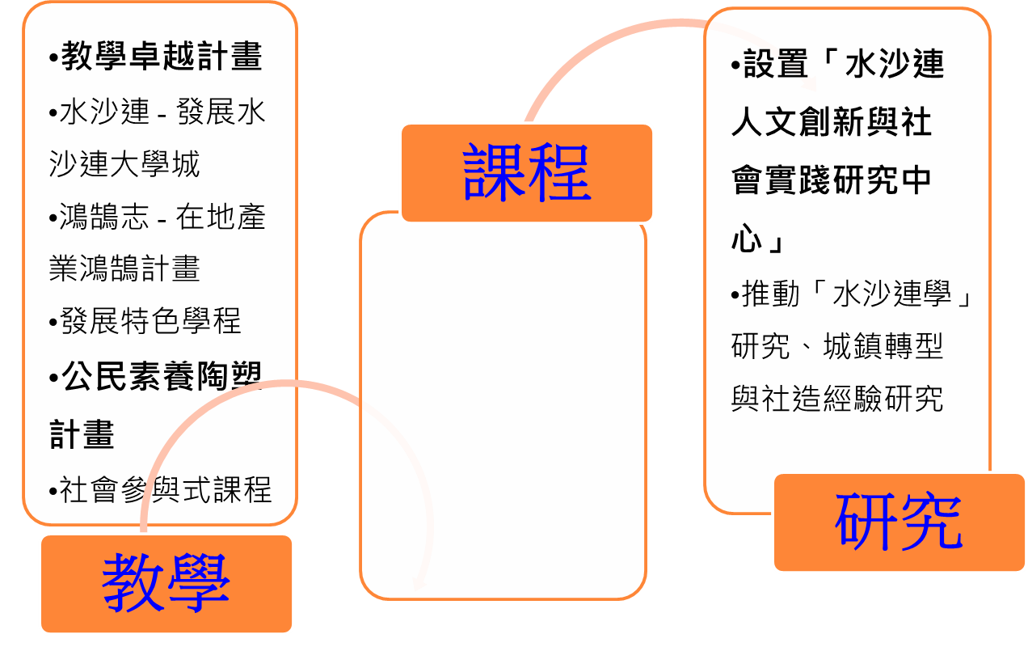
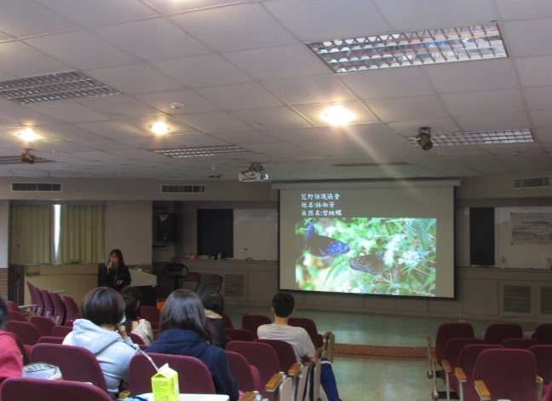
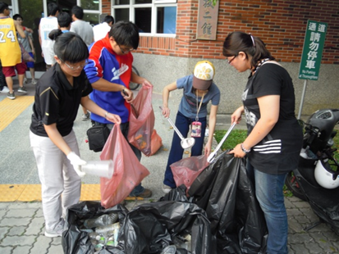
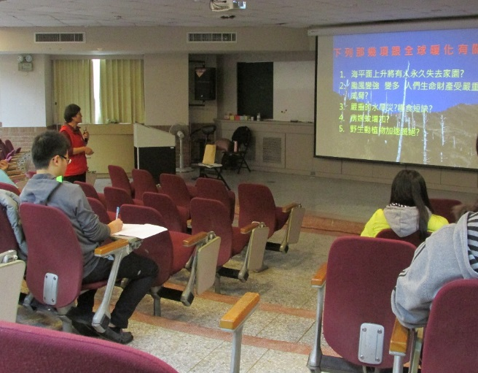
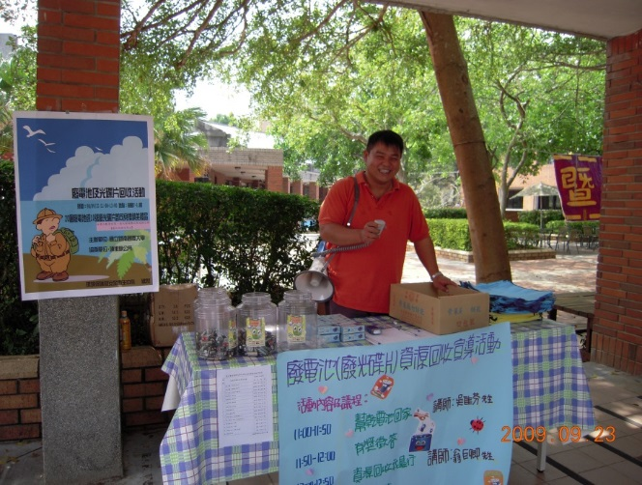
2.Educator of sustainable development (1/3)
Professional knowledge
Compound disaster prevention drill
NCNU lights-off for one hour
courses
Special courses:
Eco-Urban and Rural Planning Program, Green Environmental Protection Program
College of Humanities:
NPO management MBA program
Neighborly environment cleanup event
Become friends with nature
research
teaching
Local knowledge
Climate change seminar
Campus waste recycle talk

Slide 14
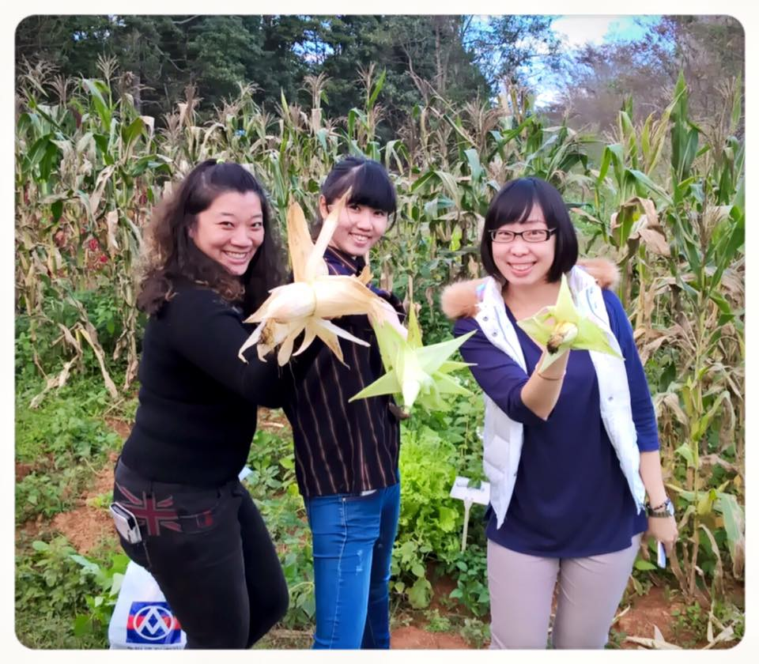
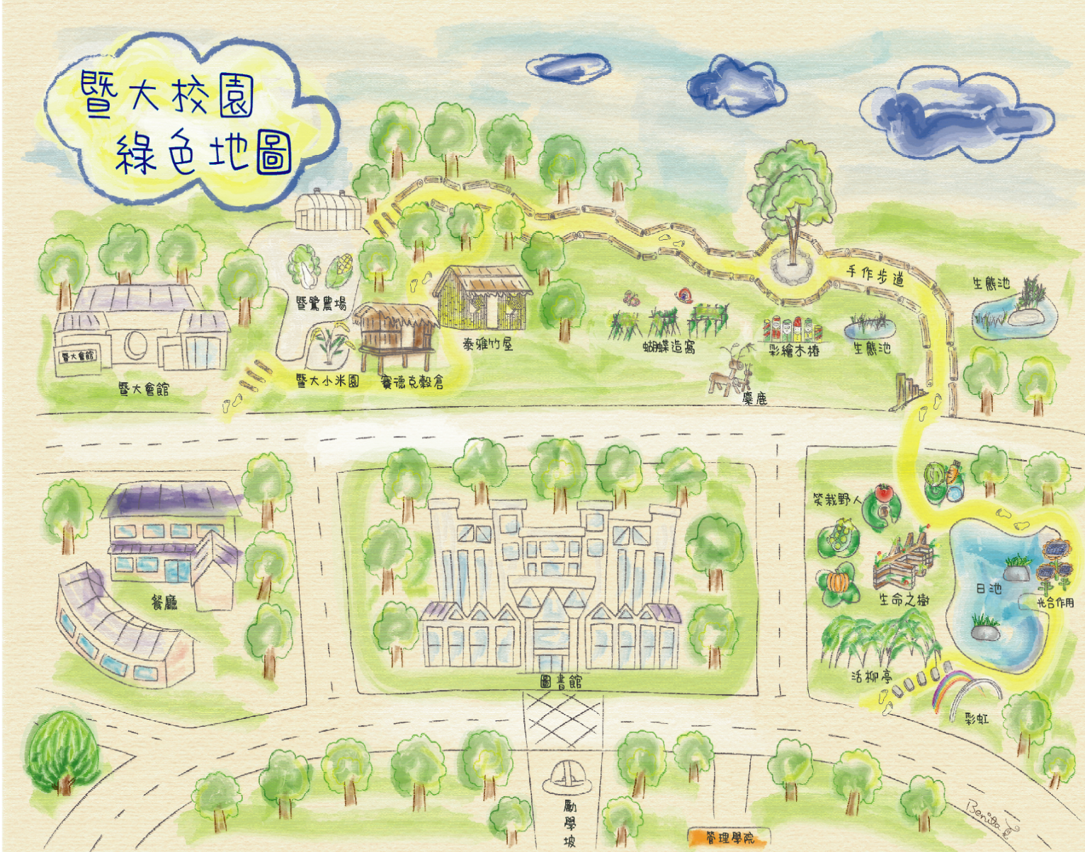
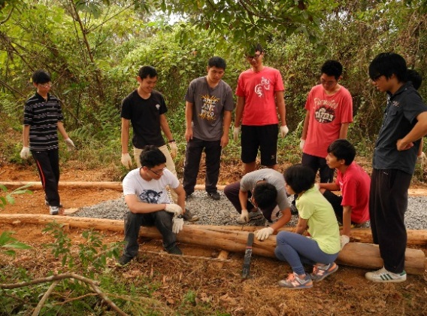
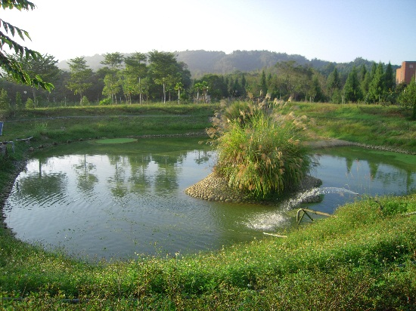
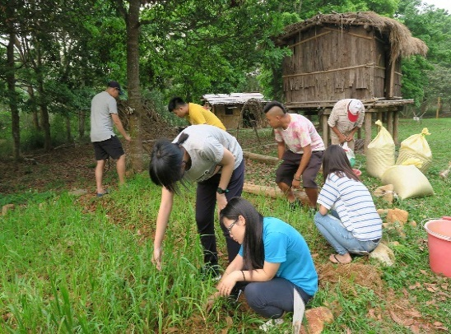
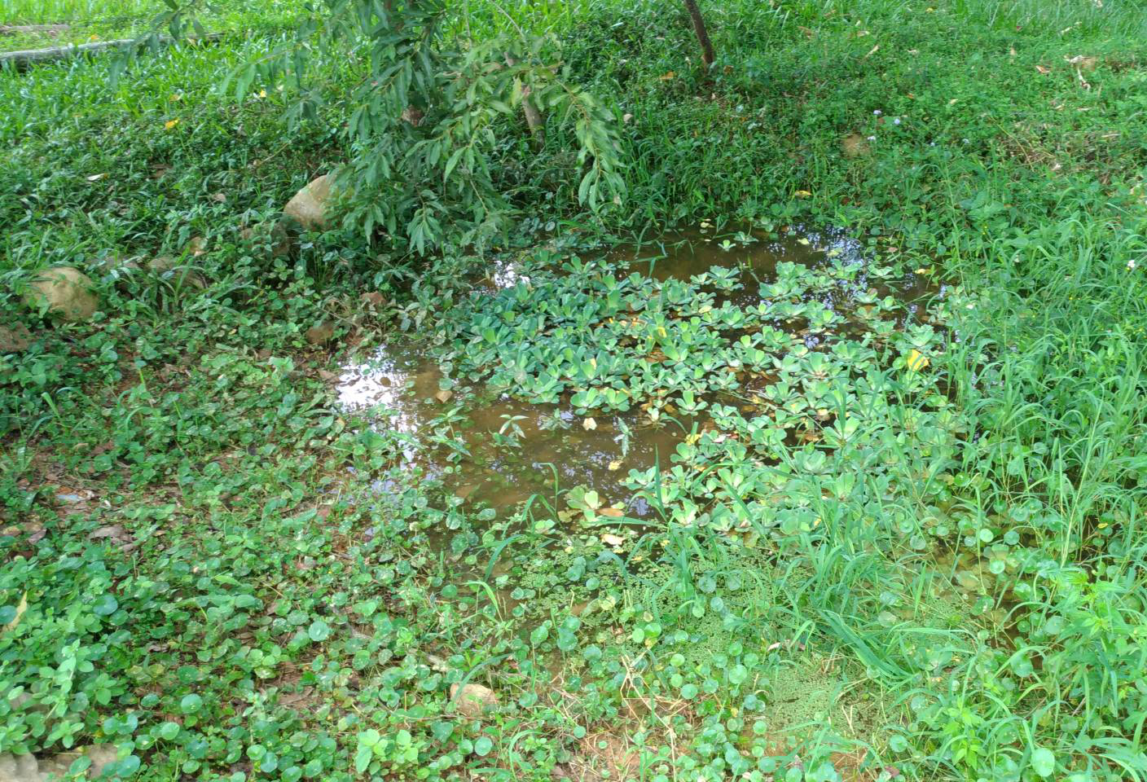
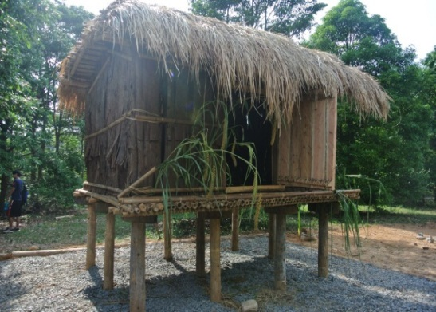
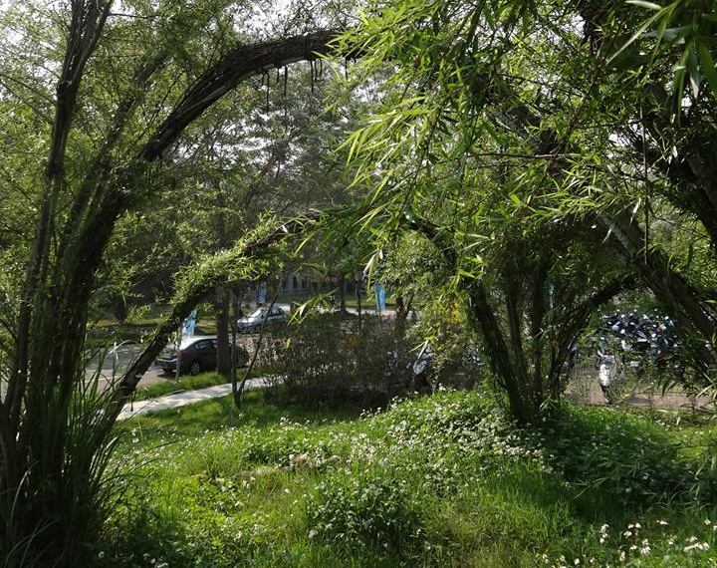
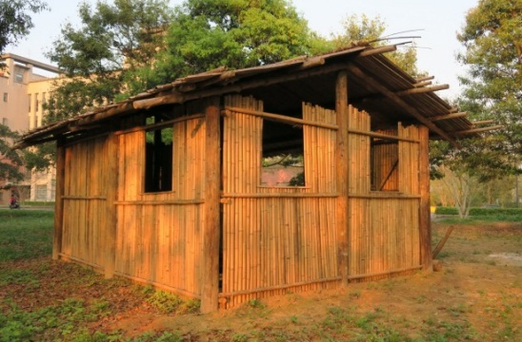
Green Campus Map
Natural Farm
Eco-craft Trail
Aboriginal Farm
Reclaimed water pond
Aboriginal Barn
(Seediq)
Ecological Pond
Aboriginal Bamboo
House (Atayal)
Butterfly Habitat

Slide 15
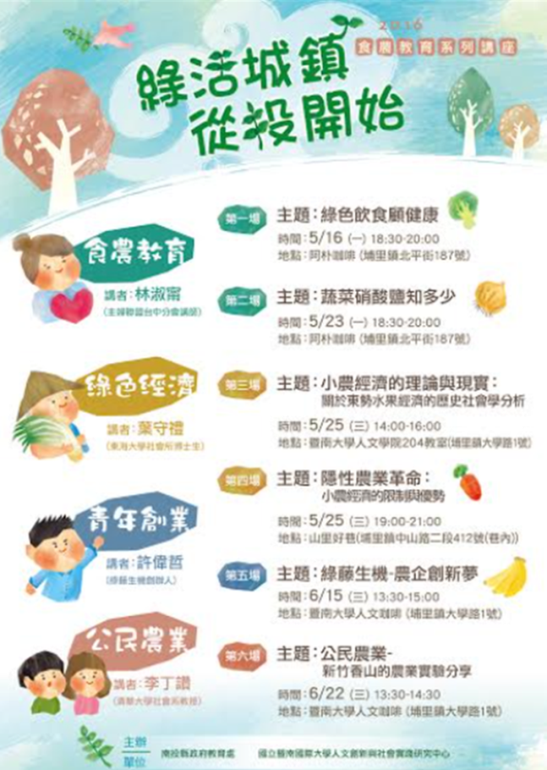
2.Educator of sustainable development (3/3)
Green town
Green aspirations
Health and food safety
Artistry maker
Hospitality services
Friendly space
Green transportation
Accumulate social capital by making public events more lively
Join Us！Build a comfortable, eco-friendly town, starting with "Nantou"
Emphasize the importance of low carbon transportation, food safety, and making sure the town eats healthy foods
Turn the creative spirits of artisans into a way of life in Nantou
Make use of green transportation and make it a habit in people's daily lives
With a friendly attitude, elevate the quality of educational destinations in Nantou

Slide 16
3. Provider of social care (1/3)
Service learning
Aboriginals
Immigrants
Senior Care
Children learning
Designing courses regarding aboriginal cultures and to establish an Aboriginal Cultural Education and Career Development Center, in which the traditional culture of the Seediq tribe in Meixi and its cultural presentations, stories, and old photographs are collected and presented; and to build traditional houses, create digital collections, and release tribal newsletters.
Reaching out to rural disadvantaged young students, by activities such as organizing parent-child picture book reading, and providing academic counseling for school children.
Establishing the Department of Southeast Asian Studies and the Southeast Asian Research Center, focusing not only on special education for overseas Chinese, but also how to help immigrants to adjust to life in Nantou.
This allows NCNU students and professors to better understand public issues of various levels in Puli; conduct in-depth studies with concepts such as community stations, problem orientation, and community design.
Conducting the senior village experimental project, where elderly members of the community connect with one another, share public gardens, community meals, as well as senior counseling and learning…

Slide 17
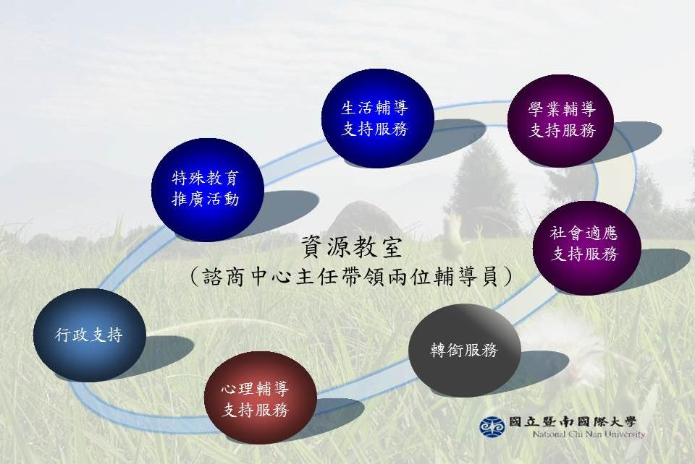
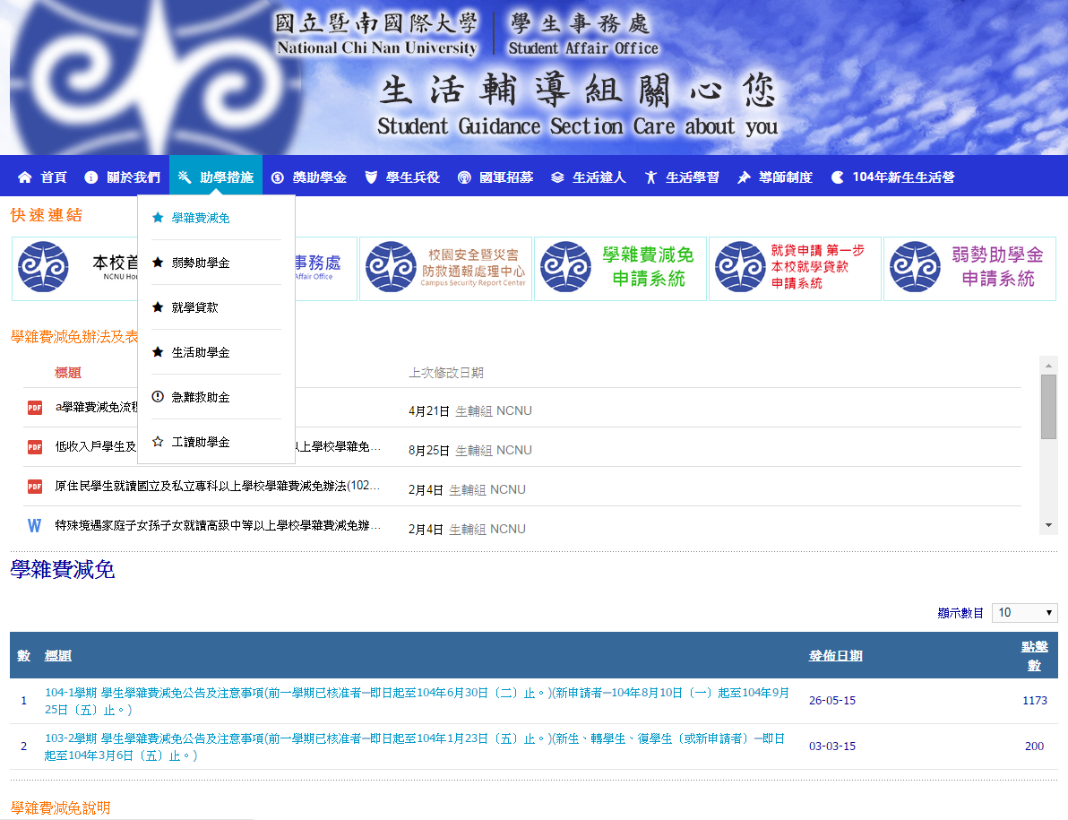
3. Provider of social care (2/3)
(Disadvantaged students make up approximately 12% of the entire student population, which is higher than any other public or private university.)
Scholarships for Disadvantaged Students: NTD1,000,000
Living Expense Grants: NTD3,510,000
Emergency Allowances:NTD 600,000
Work-study Grants: NTD9,140,000
On this beautiful campus, the Resource Classroom is a caring and free space that incorporates both knowledge and sensitivity, offering comprehensive care to our students.

Slide 18
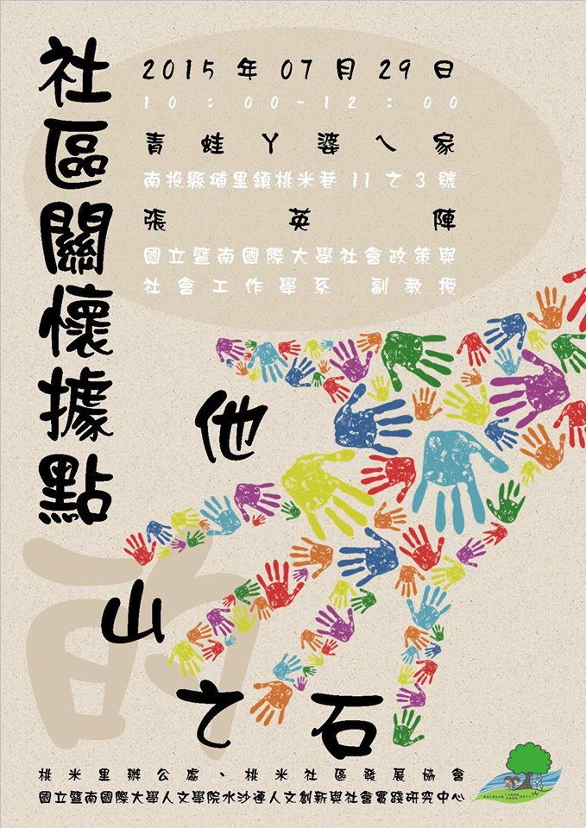
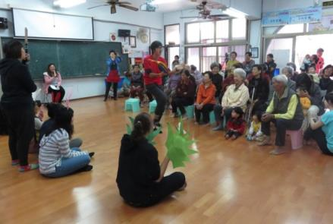
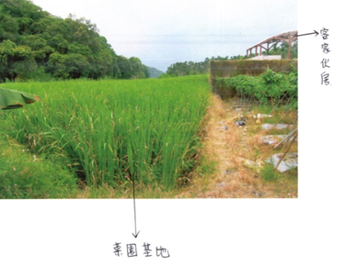
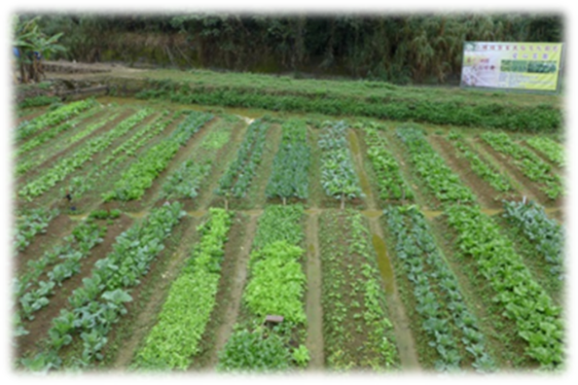
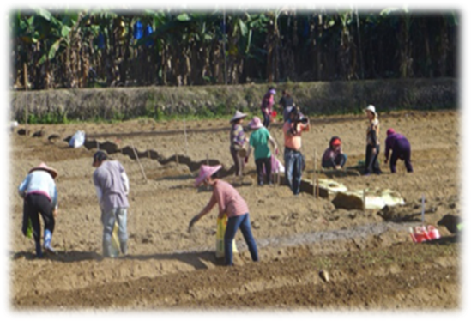
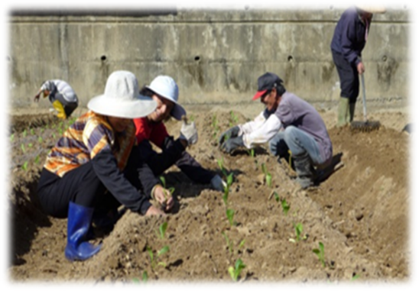
3. Provider of social care (3/3)
"From a vacant area to a community garden"
Providing food for seniors
--Guangcheng community
Community theater
Apu's "New" Home Empowerment Project

Slide 19
4. A leader in community building
2013 The First Phase of "Humanities Innovation and Social Activism" Project, funded by the Ministry of Science and Technology.
2016 The Second Phase of "Humanities Innovation and Social Activism" Project, funded by the Ministry of Science and Technology.
August 2016: The Center being promoted to the university level with brooder responsibility.
2013.5.29 Established the Shui Sha Lian Humanities Innovation and Social Activism Research Center in college of humanities.
Call Spring for Shui Sha Lian: Transition and Governance of a Livable Township
Establish the Shui Sha Lian College Town: multi-level, cross-disciplinary space
Integration of school and local resources to promote important issues and fulfill the University's Social Responsibility

Slide 20

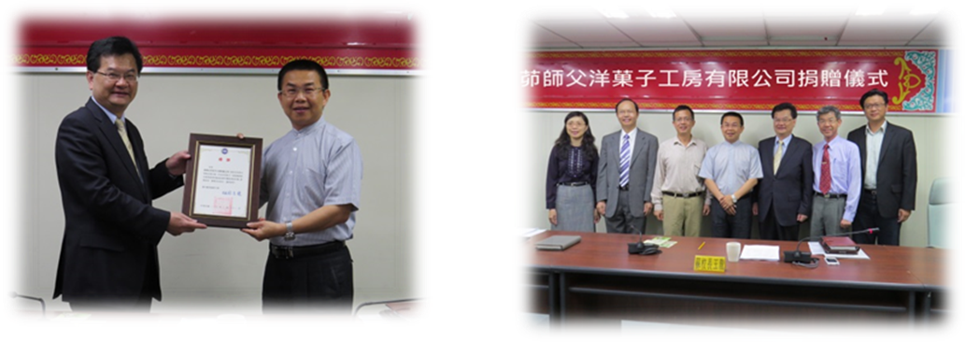
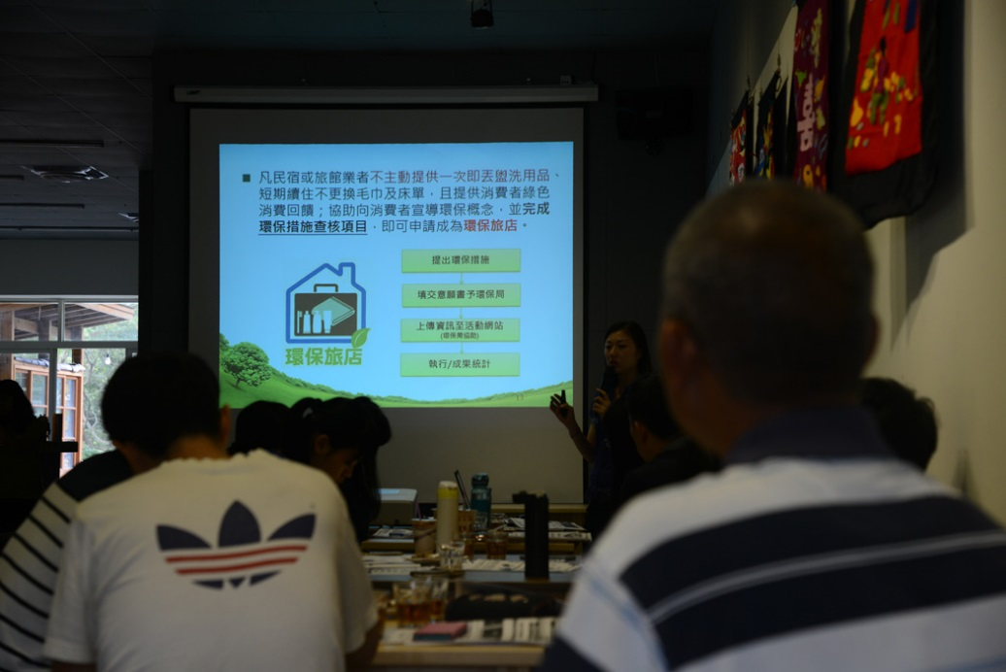
5. Practitioner of social responsibilities
No pollution, zero disasters, and enforcing energy conservation and carbon reduction
Shoulder social responsibilities, playing the role as local think tank and to cultivate new talent
Integrate local and school resources to promote important issues
Received the highest honor of "Five Star Award of Establishments Providing Employees with Safe and Sanitary Spaces" from the Ministry of Labor
Notes:
1.環保旅店:希望桃米生態村民宿業者可一起加入環保旅店的推動行列。暨大人社中心並媒合陳智峰師生，協助有意願的民宿彙整相關申請資料。期望，未來桃米生態村的民宿，能與訪客共同守護地球。
2.面對城鎮環境問題，如何面對與解決？暨大結合18℃以跨社群協力力量(推展埔里環境清潔運動)

Slide 21
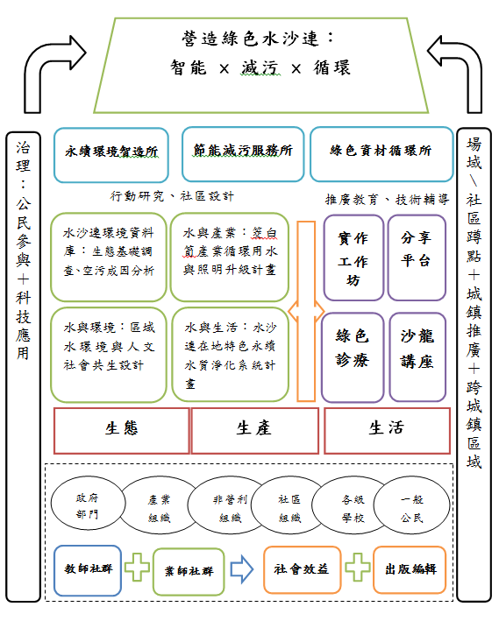
IV. Major Tasks and Current Objectives
University with Unique Characteristics
Suishalien College Town
University without Borders
University Social Responsibility (USR)
Major Tasks:
Sustainable Green University
University Social Responsibility (USR)
Helping Southeast Asia immigrants adjust to their new life in Puli.
Nurturing outstanding Southeast Asia students to return to their respective homeland to work.
Bridging the education gap between urban and rural areas.
Cultivating the ability of intellectual youths to return to their hometown.
Maintaining cultural diversity and to promote the exchange and integration of diverse cultures.

Slide 22






Current objectives: 3 perspectives (ecological, production, lifestyle)
Ecological perspective(1/2)
The goal of promoting ecological awareness and environment restoration;
Issues include: PM2.5 air pollution awareness, water resources environment inspection, safe community and disaster prevention environmental education, etc.
Promote environmental awareness among different social groups and inspire them to take action through two strategies: "monitoring environmental information" and "civic science education".

Slide 23
Local partnership plan: ecological perspective(2/2)
Issues | Partners | Project plan | Spatial scale
 |  |  | Single community | Cross-community | The entire township
PM2.5 air pollution monitoring device installed by volunteers | Puli PM2.5 Air Pollution Reduction Group, Puli Township Office Air Pollution Prevention Committee, New Home Foundation, Environmental Protection Agency, Puli Temple Association | Develop low-tier pollution detectors, civic science volunteer training, eco-friendly temples, community theater, policy announcement and debate |  |  | ●
Water resource investigation and water environment construction | Taomi Community, Lancheng Community, Meixi Tribe, Dongguang Community, Wu Gong Community, Water Resource Agency, Ministry of Economic Affairs | Low carbon community (recycle water resources), water environment resource investigation and community conservation... | ● | ● | ●
Safe community and disaster prevention and relief | Taomi Village Office, Taomi Community development association, Taomi agricultural recreation promotion association, New Home Foundation, Taoyuan Elementary School, Meixi Tribe, Wu Gong Community Development | Proactive disaster prevention drills, cross-community exchanges, safe community | ● | ●
Community environmental education empowerment | Taomi community, Lancheng community, Meixi tribe, Wi Gong Community, Taian Village, New Home Foundation, Puli PM Puli PM2.5 Air Pollution Reduction Group, etc. | Environmental education seminars and community design, environmental education fair, adopt a space | ● |  | ●

Slide 24




Production Perspective(1/2)
Goal of integrating local networks with social economics.
Issues include: friendly farming, food/farming education, youth startup and eco-tourism.
Start with agriculture issues, attempt to figure out the possibility of establishing a supply and sales system within the community, set up a network based on food/farming education as learning experiences, and attempt to develop a feedback system within the community or cross-communities to build a positive economic model.

Slide 25
Local partnership plan: production perspective(2/2)
Issues | Partners | Project plan | Spatial scale
 |  |  | Single community | Cross-community | The entire township
Food/farming Education | Zhuzai Mountain Community Development Association, Xinan Elementary School, Lancheng Community | Agricultural classroom (Lancheng), community-farmed garden (Zhuzai Mountain), creating lunar calendars | ● | ●
Friendly Agriculture | Puli Good Rice, Quarter to TEN, Puli Organic Association, Hao Jiao Cing, Green Birth Farm, Good Alley, etc. | Community crop field management seminar | ● | ● | ●
Youth Entrepreneurship | Puli Cultural and Creativity Association, Good Alley, Puli Good Rice, Alley Cultural Travel, 545 Bike... | Youth farmers Internet platform | ● |  | ●
Ecology Tourism | Taomi Community, Yixin Community, Meixi Tribe, Nantou Hostel Association, New Homeland Foundation , Maple Community | Humanities and nature guided tour, working holiday, cross-community tour design and implementation, eco-friendly hotels, electric bicycle tours | ● | ●

Slide 26




Lifestyle Perspective(1/2)
Its focus is the network of daily assistance.
Issues include: mutual cooperation among seniors, cross-ethnicity culture, children learning, a learning city (green town).

Slide 27
Local partnership plan: lifestyle perspective(2/2)
Issues | Partners | Project plan | Spatial scale
 |  |  | Single community | Cross-community | The entire township
Seniors Helping each other | Lancheng Community, Taomi Community, Meixi Tribe, Puli Senior Village, and Vogai Tribe | Neighboring villages helping each other, community garden, community meals, senior education... | ● | ●
Children Learning | Taomi Community, Meixi Tribe, Fu Xing District, Wu Gong community | Parent-children picture book reading and creation, community academic counseling, training little tour guides... | ● | ●
Cross-ethnicity Culture | Meixi Tribe, Wu Gong Society, South Village Society, Maple Society, Lancheng Society, Jungyuan Tribe, Qingliu Tribe, and Daguan Tribe | Community theater, community (tribe) newsletter, map of the tribe... | ● | ●
Learning City | Department of Education, County Administration, Puli Cultural and Creativity Association, Puli Tourism Promotion Association, Nantou Community College Puli Branch, Nantou County Tour Guide Association, Nantou Hostel Association | Civic reporter empowerment, youth orchestra, green tourism, lifestyle museum... | ● | ● | ●

Slide 28

V. Future Aspirations
On May 30, 2015, a survey conducted by NCNU found that the Puli people in Puli have a very positive view of NCNU's local participation.

Slide 29
V. Future Aspirations
Follow the Ministry of Education's higher education initiatives
Cultivate universities with unique characteristics
Become the benchmark university
Work towards mutual prosperity to achieve sustainable development with local communities

Slide 30


End of briefing
Thank you
http://www.ncnu.edu.tw/ncnuweb/

